Slide 1
Agenda
Project - VBA
Summary Sheet
Dashboard Sheet

Slide 2
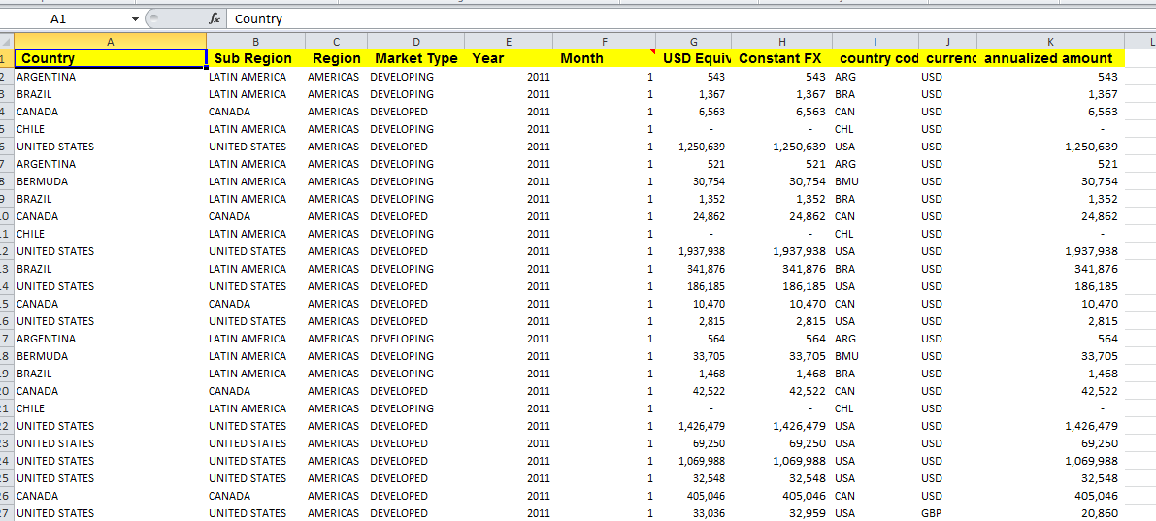
Project
Now, we need to create a project report using our VBA Skills. The dataset we need to use is given below:-

Slide 3
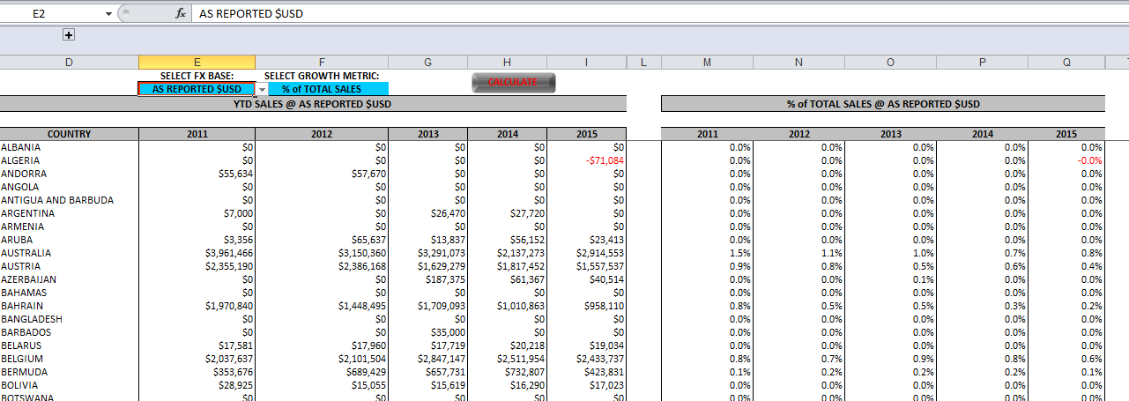
Project - Summary Sheet
Using this Dataset, we need to create a Summary sheet as given below.
It contains two sections - Sum of Sales(left section) by country and Growth Metrics(right section)

Slide 4
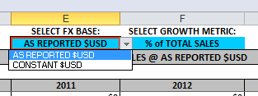
Project - Summary Sheet
2. The Sum of sales and Growth metrics calculation depends on two drop downs
SELECT FX BASE:
SELECT GROWTH METRIC:
3. When we select “AS REPORTED $USD” both of these sections should be calculated on [USD Equiv] column. If we select “CONSTANT $USD”, both sections should be calculated on [Constant FX] column.

Slide 5
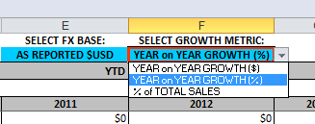
Project - Summary Sheet
4. In the second drop down, we have three values in the same order.
YEAR on YEAR GROWTH ($)
YEAR on YEAR GROWTH (%)
% of TOTAL SALES
YEAR on YEAR GROWTH ($) : -Difference between current year’s sale from last year’s sale.
YEAR on YEAR GROWTH (%):- % growth from last year
% of TOTAL SALES :- % of Sale in this country to total Sale

Slide 6
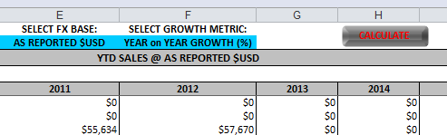
Project - Summary Sheet
4. All of the above calculations should be done on one Button Click called Calculate. All the formulas in this sheet should be calculated and pasted as value .
So when I click on ”Calculate” button both section should contain numbers( no Formula) based on these two drop downs.

Slide 7
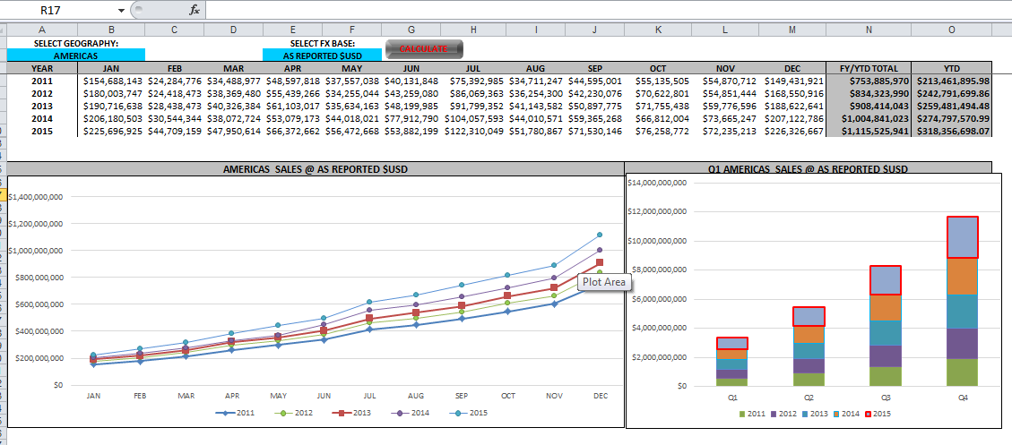
Project - Dashboard Sheet
1. Another sheet(called Dashboard), will contain a summary of sale on year at the top and two chart - Trend Chart and Stacked bar chart.
The Trend chart shows trend for each month in these years and stacked chart shows quarterly Sale for each year as given below.

Slide 8
Project - Dashboard Sheet
2. This tab also contain two drop downs and summary in the table is created based on the drop down selection.
SELECT GEOGRAPHY
SELECT FX BASE:
For example , if we select “AMERICAS” in and in drop down two “CONSTANT $USD” then click on “Calculate” both the charts and summary table should be updated based on selection(in drop down).

Slide 9
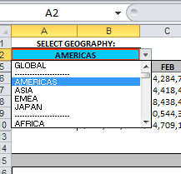
Project - Dashboard Sheet
The drop down for Geography should contain the below given things(All of these are available in dataset):-
Global - for showing sum of all the regions, need to calculate
Four regions ( Americas, Asia, EMEA and Japan)
Sub Region like Africa, Latin America etc.
Market Type like Developed, Developing
Country – Name of all the countries
The used of this Dashboard should be able to aggregate (sum) the sales on any of the above things.
We need to use VBA for all the calculation as we want this file to be as light as possible. The user should not be able see any formulas but only the aggregated values.

Slide 10
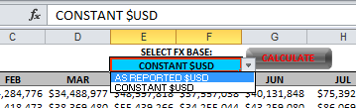
Project - Dashboard Sheet
The FX Base drop down should have the same three values as in previous sheet.
YEAR on YEAR GROWTH ($)
YEAR on YEAR GROWTH (%)
% of TOTAL SALES
YEAR on YEAR GROWTH ($) : -Difference between current year’s sale from last year’s sale.
YEAR on YEAR GROWTH (%):- % growth from last year
% of TOTAL SALES :- % of Sale in this country to total Sale

